Slide 1

Title: Body Control Module (BCM) with Basic OBD support (UDS)
Sub title: Automotive BCM with CAN & OBD-II Diagnostics
TEAM:
Amith K M
Amulya S Gupta
Chitra P S
Geethashree G
Niranjan Gowda V
Rahul Malagavi
DEPT. OF ECE, DBIT

Slide 2
Outline of the Presentation
WEEK 1
WEEK 2
Team Roles & Structure
Week 1 (Embedded & Diagnostics Team)
Week 2 (Embedded & Diagnostics Team)
Week 1 (Software & Application Team)
Week 2 (Software & Application Team)
Week 1 (Planning & Documentation Team)
Week 2 (Planning & Documentation Team)
Summary

Slide 3
Team Roles & Structure
WEEK 1
WEEK 2
BCM
Embedded & diagnostic team
Software & application team
Planning & documentation team
UDS service developer
CAN comm & protocol handler
DTC developer
Tool & interface developer
Software testing & debugging
Documentation & report support
Amulya s Gupta
Geethashree G
Amith K M
Niranjan Gowda v
Rahul Malagavi
Chitra P S

Slide 4
SUMMARY (EMBEDDE AND DIAGNOSTIC TEAM)
WEEK 1
WEEK 2
Amulya :
Studied UDS 0x10 & 0x22 service structure and use cases.
Drafted pseudo code for both services.
Created JIRA board, project setup, task assignment, and team planning.

Slide 5
SUMMARY (EMBEDDE AND DIAGNOSTIC TEAM)
WEEK 1
WEEK 2
Geethashree G:
Reviewed CAN protocol structure.
Understood CAN ID structure for BCM communication.
Amith K M:
Studied UDS 0x19 for DTC management.
Drafted sample DTC handling flow.

Slide 6
PLAN (EMBEDDE AND DIAGNOSTIC TEAM)
WEEK 1
WEEK 2
Amulya :
Implement UDS 0x10 & 0x22 on STM32 or simulation environment.
Simulate and verify responses.
Begin UDS 0x2E service study.
Continue JIRA tracking and guide team with task allocation.

Slide 7
PLAN (EMBEDDE AND DIAGNOSTIC TEAM)
WEEK 1
WEEK 2
Geethashree G:
Finalize CAN ID mapping.
Develop CAN send or receive signal.
Integrate CAN layer with UDS Services.
Amith K M:
Implement UDS 0x19 service & simulate DTCs and observe behavior.
Draft logic for 0x41 (clear DTCs).

Slide 8
SUMMARY (SOFTWARE AND APPLICATION TEAM)
WEEK 1
WEEK 2
Niranjan Gowda v:
Explore Python CAN libraries.
Created basic test script for UDS service simulation.
Rahul malagavi :
Reviewed UDS request/response pattern.
Designed simple validation tests for 0x10 and 0x22.

Slide 9
PLAN (SOFTWARE AND APPLICATION TEAM)
WEEK 1
WEEK 2
Niranjan Gowda v:
Enhance UDS tester script with custom input/output fields.
Begin simple GUI layout for UDS testing.
Rahul malagavi :
Write test cases for UDS 0x10, 0x22 and 0x19.
Perform unit and integration testing.
Collaborate with embedded team to validate results.

Slide 10
SUMMARY (PLANNING AND DOCUMENTATION)
WEEK 1
WEEK 2
Chitra P S:
Assisted in organizing and reviewing documentation.
Supported creation of task list under guidance.

Slide 11
PLAN (PLANNING AND DOCUMENTATION)
WEEK 1
WEEK 2
Chitra P S:
Update notion with logs and shared documents.
Assist with formatting weekly slides and reports.
Maintain weekly summary reports and timeline sheets.

Slide 12
SUMMARY
WEEK 1
WEEK 2
Team roles established with clear responsibilities.
Week 1 focused on foundational work.
Week 2 shifts toward implementation and validation.
JIRA tracking, simulation, and testing efforts continue across departments.

Slide 13
Thank You

Slide 14
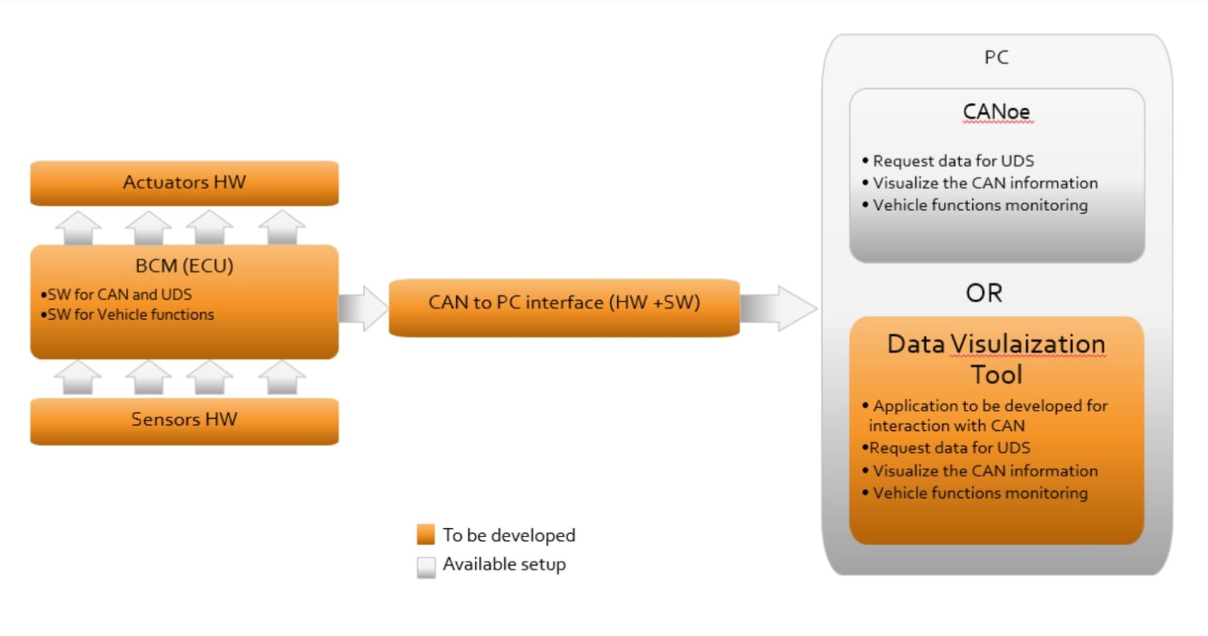
System Architecture
Project Overview
Problem Statement
System Architecture
Roles & Responsibilities
Way Of Working
Tools & Technologies Used
Project Timeline
Testing & Validation

Slide 15
Roles & Responsibilities
Project Overview
Problem Statement
System Architecture
Roles & Responsibilities
Way Of Working
Tools & Technologies Used
Project Timeline
Testing & Validation
Embedded Systems & Diagnostics Engineer
Responsible for developing the BCM software, implementing CANFD and UDS protocols, and handling diagnostic testing and fault simulation.
Hardware Integration & Testing Engineer
Manages setup of the microcontroller, sensor/actuator interfacing, power management, and conducts system-level validation and testing.
Tool Development & Project Coordinator
Designs the real-time data visualization tool, maintains technical documentation, and oversees timeline tracking and team coordination.

Slide 16
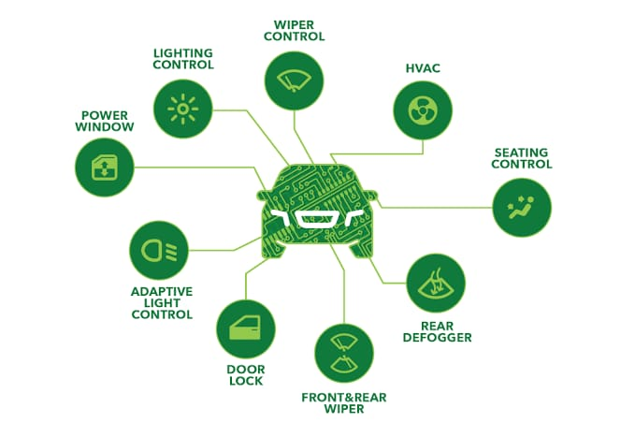
Way Of Working
Project Overview
Problem Statement
System Architecture
Roles & Responsibilities
Way Of Working
Tools & Technologies Used
Project Timeline
Testing & Validation
Development Methodology: Agile approach using a Kanban board to track progress and manage tasks.
Communication & Collaboration Tools:
JIRA – Task tracking
GitHub – Version control
Notion – Documentation
Figma – UI/UX planning
Coding Approach: Modular code structure for ease of debugging, testing, and future scalability.
Documentation: Maintained in Notion and GitHub for clear version tracking and review.

Slide 17
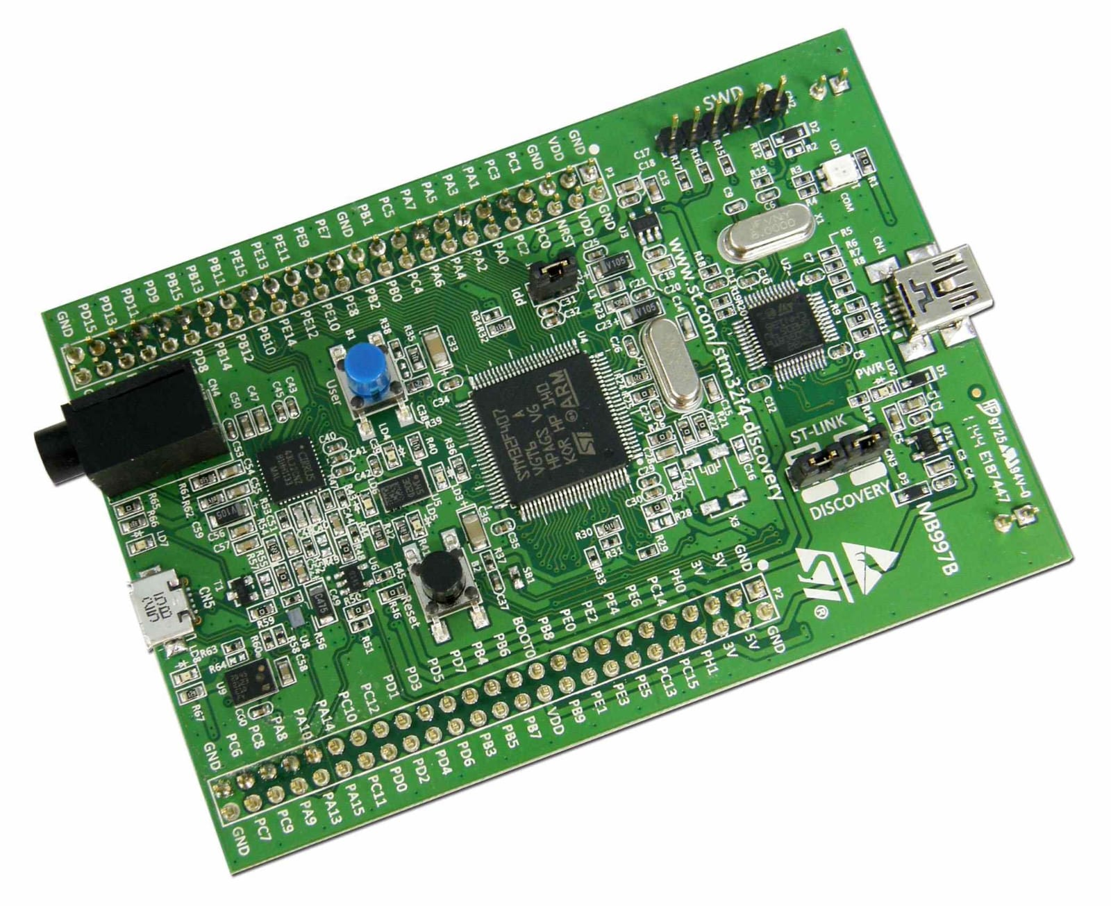
Tools & Technologies Used
Project Overview
Problem Statement
System Architecture
Roles & Responsibilities
Way Of Working
Tools & Technology Used
Project Timeline
Testing & Validation
Microcontroller & Hardware:
STM32F4 development board
CAN transceiver (MCP2562)
Sensors & actuators
Software Tools:
STM32CubeIDE – Firmware development
Fig:STM32F4 development board

Slide 18
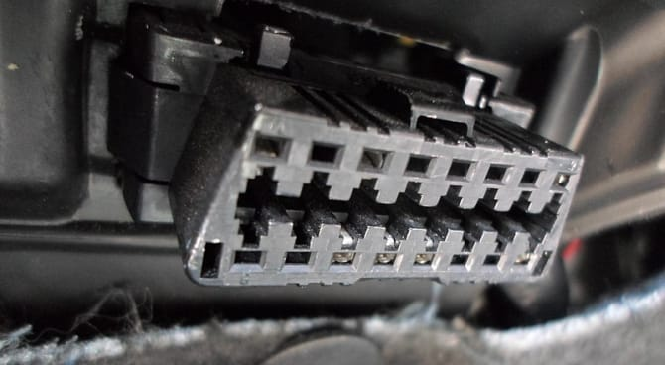
Tools & Technologies Used
Project Overview
Problem Statement
System Architecture
Roles & Responsibilities
Way Of Working
Tools & Technology Used
Project Timeline
Testing & Validation
GitHub – Version control
Notion – Documentation
Communication Protocols:
CANFD – High-speed in-vehicle communication
UDS (ISO 14229) – Diagnostic services
OBD-II – External diagnostics interface
Fig: OBD-II PORT

Slide 19
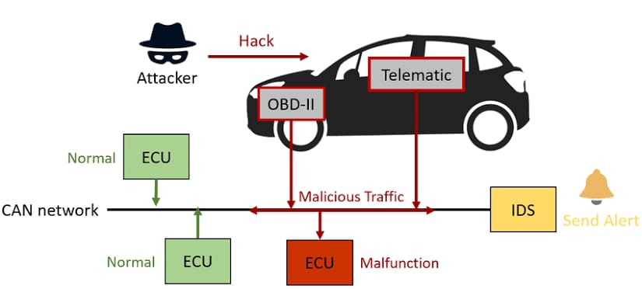
Project Timeline
Project Overview
Problem Statement
System Architecture
Roles & Responsibilities
Way Of Working
Tools & Technologies Used
Project Timeline
Testing & Validation
Phase 1: Requirement Analysis
Understand BCM functionality, UDS protocol, and CANFD basics.
Phase 2: System Design
Finalize architecture and define roles.
Prepare initial block diagram and documentation.
Phase 3: Development
Start BCM coding and CAN communication setup.

Slide 20
Project Timeline
Project Overview
Problem Statement
System Architecture
Roles & Responsibilities
Way Of Working
Tools & Technologies Used
Project Timeline
Testing & Validation
Implement UDS services.
Phase 4: Integration & Testing
Connect hardware and test communication.
Perform diagnostics and fault testing.
Phase 5: Tool Development & Finalization
Build data visualization tool.
Final testing, documentation, and presentation

Slide 21
Testing & Validation
Project Overview
Problem Statement
System Architecture
Roles & Responsibilities
Way Of Working
Tools & Technologies Used
Project Timeline
Testing & Validation
Unit Testing
Integration Testing
Fault Injection
OBD-II Testing
Traceability

Slide 22
Conclusion
Project Overview
Problem Statement
System Architecture
Roles & Responsibilities
Way Of Working
Tools & Technologies Used
Project Timeline
Testing & Validation
Developed a working BCM system for basic vehicle control.
Used CANFD and UDS for communication and diagnostics.
Gained hands-on experience in embedded systems and automotive protocols.
Followed a modular approach with good teamwork and planning.
The project reflects key skills needed in the automotive industry.

Slide 23
Future Scope
Project Overview
Problem Statement
System Architecture
Roles & Responsibilities
Way Of Working
Tools & Technologies Used
Project Timeline
Testing & Validation
Extend BCM to control additional features like HVAC, mirrors, and seat motors.
Implement remote diagnostics using wireless or cloud-based access.
Add OTA (Over-the-Air) update support for firmware upgrades.
Integrate cybersecurity features for secure UDS communication.
Simulate a full vehicle network using tools like CANoe or Vector VT System.
Use machine learning for early fault prediction and health monitoring.

